Slide 1
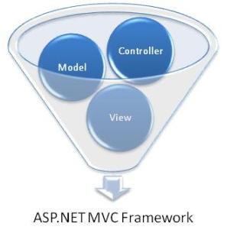

Web Applications with ASP.NET MVC
Course Introduction
Svetlin Nakov
Telerik Corporation
www.telerik.com

Slide 2

Table of Contents
About Telerik
About Telerik Academy
About the Course
Requirements
Course Schedule
Course Curriculum
The Trainers Team
Assessments
Recommended Books

Slide 3


About Telerik

Slide 4

About Telerik
What Telerik does?
Leading vendor of ASP.NET AJAX, Silverlight, WPF, Window Phone 7 and ASP.NET MVC components, ORM, Reporting, and CMS solutions and Visual Studio plugins
Headquartered in Bulgaria
With offices in USA, Germany, Australia, India
450 employees – mostly developers
Employer #1 in Bulgaria for 2010
Microsoft Gold Certified Partner

Slide 5
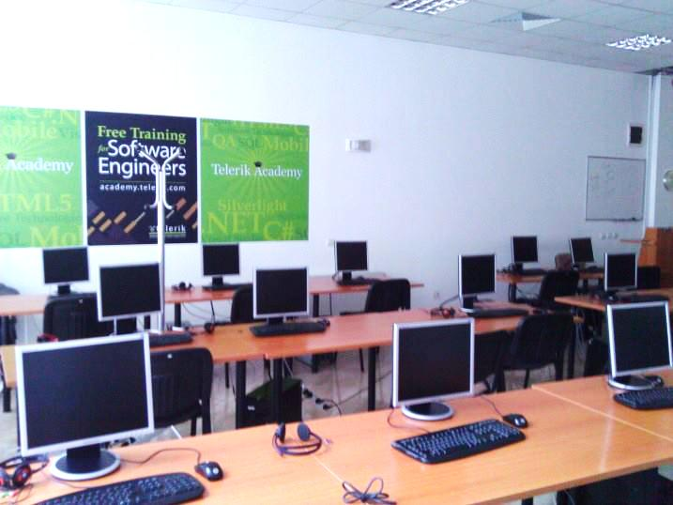
About Telerik Academy
Telerik Academy is an initiative Telerik for training of young software engineers
Four main streams
Software Academy
.NET Essentials
QA Academy
Developer Support
School Academy
Kids Academy
Student Courses

Slide 6
Academy at a Glance
Kids Academy
University Courses
School Academy
Software Academy
C# Fundamentals
.NET Essentials
QA Academy
Developer-Support
Job at Telerik

Slide 7
Free Courses for Students
Courses for Students
Cross-Platform Mobile Applications (starting October, FMI)
Native Mobile Development (iOS, Android, Windows Phone 7)
(starting March)
Web Applications with ASP.NET MVC
(starting October, FMI)
High-Quality Programming Code (starting March)
Web Client-Side Development (starting October)
XAML Development
(starting March)
Search Engine Optimization (starting November)
Web Front-End Development
(starting March)

Slide 8

About the MVC Course
"Web Applications with ASP.NET MVC" course objectives
Provides basic skills for development of dynamic ASP.NET MVC Web applications
C# language fundamentals
Databases and SQL Server
LINQ and Entity Framework
WWW, HTTP, HTML5, CSS3
JavaScript, jQuery
ASP.NET MVC

Slide 9



Requirements to the Students
Computer programming skills
One of the following languages:
C#, Java or C++
Object-oriented programming
Abstraction, encapsulation, inheritance, polymorphism, exceptions handling
English language
All training materials are in English (intentionally, Telerik Academy policy)

Slide 10
Required Software
Visual Studio 2010
With Service Pack 1 and latest updates
Web Platform Installer (Web PI) will install everything you need for developing ASP.NET MVC applications
http://www.asp.net/mvc
Microsoft SQL Server 2008 R2
SQL Server Management Studio
You may also want to try latest version of the ASP.NET MVC 4 (development preview)

Slide 11
Registration
All students should register for the course at:
Registration is important!
Registration allows the trainers contact you regarding the course projects, exams, etc.
Registered students are assigned to work on one of the course projects
If you have any questions you can contact us:
http://mvccourse.telerik.com
academy@telerik.com

Slide 12

Course Schedule
Sofia University – FMI
Every Monday, 18:00-21:00, Lab 229
Start: 10th October 2011
Telerik Academy – New Training Lab
Every Thursday, 18:00-21:00,
Start: 20th October 2011
Located in: Mladost 1A, Alexander Malinov blvd. 31

Slide 13

Course Curriculum

Slide 14
Curriculum
.NET Framework Overview
.NET, CLR, MSIL, Assemblies, CTS, .NET languages
C# Language Overview – Part I
Data Types, Operators, Expressions, Statements, Console I/O, if / switch / case, Loops, Arrays, Methods
C# Language Overview – Part II
Creating and Using Objects, Exceptions, Strings, Generics, Collections, Attributes
Object-Oriented Programming with C#
Defining Classes, Constructors, Properties, Methods, Events, Interfaces, Inheritance, Polymorphism

Slide 15
Curriculum (2)
Databases, SQL and MS SQL Server
RDBMS, SQL Language, SQL SELECT, Joins, Grouping, SQL INSERT, SQL UPDATE, SQL DELETE, MS SQL Server, SQL Server Management Studio
LINQ and ADO.NET Entity Framework
LINQ Operators and Expressions, Projections, Conversions, Aggregations, ADO.NET Entity Framework: Read / Create / Update / Delete Data
Web Technologies Basics and HTML
WWW, HTTP, Request-Response, HTML Fundamentals, Tags, Tables, Forms, etc.

Slide 16
Curriculum (3)
CSS and CSS3
Selectors and style definitions, Fonts, Backgrounds, Borders, The Box Model, Alignment, Margin, Padding, Visibility, Display, Overflow, etc.
JavaScript
Operators, Data Types, Statements, Loops, etc.
jQuery and HTML5
jQuery Fundamentals, AJAX, jQuery UI, HTML5
ASP.NET MVC part 1
MVC, Simple Project, Conventions, Routes, Models, Controllers, Views, Razor, Helpers, Typed Views

Slide 17
Curriculum (4)
ASP.NET MVC part 2
Unit testing, test-driven development, NuGet package management, Deployment and Security
ASP.NET MVC part 3
MVC Scaffolding, AJAX with ASP.NET MVC, Best practices, Monitoring
Some other advanced topics
Practical Project Live Demo
Practical Projects Defense (Certification Exam)

Slide 18

The Trainers Team

Slide 19
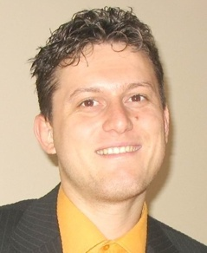
Trainers Team
Svetlin Nakov, PhD
Manager Technical Training
Telerik Corporation
20 years software development experience
Author of 6 books
Speaker of hundreds of events
E-mail: svetlin.nakov [at] telerik.com
Web site: www.nakov.com

Slide 20

Trainers Team (2)
Nikolay Kostov
Technical Trainer
Telerik Corporation
Telerik Academy
3rd year student in FMI
E-mail: nikolay.kostov [at] telerik.com
Web site: www.nikolay.it

Slide 21
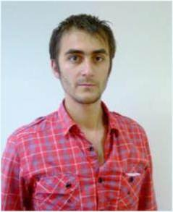
Trainers Team (3)
Doncho Minkov
Technical Trainer
Telerik Corporation
Telerik Academy
4th year student in FMI
E-mail: doncho.minkov [at] telerik.com
Web site: donchominkov.blogspot.com

Slide 22

Trainers Team (4)
Ivan Zhekov
Front-End Developer
Telerik Corporation
ASP.NET Team
Web site: joneff.info
E-mail: ivan.zhekov [at] telerik.com

Slide 23
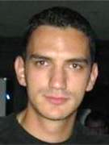
Trainers Team (5)
Vesko Kolev
Senior Software Engineer
Telerik Corporation
Centaur Team
Email: vesko.kolev [at] telerik.com
Blog: veskokolev.blogspot.com

Slide 24

Trainers Team (6)
Ventsy Popov
Microsoft Certified Trainer
Microsoft Certified Professional
Blog: ventsypopov.com
Email: ventsy.popov [at] gmail.com

Slide 25

Trainers Team (7)
Alexander Vakrilov
Software Engineer
Telerik Corporation
Centaur Team
Email: аlexander.vakrilov [at] telerik.com

Slide 26


Assessment
Exams, Grades, Certifications, Awards

Slide 27

Assessment
Practical project
The practical project will consist of two parts:
Data Access Layer and Web UI prototype
Dynamic Web application – developed at home
Based on .NET Framework, ASP.NET MVC, HTML5, SQL Server and Entity Framework
Examples:
Photo album
CMS system
Blog system

Slide 28

Assessment (2)
Defending the projects
Students should defend their projects in class
Will be asked to extend the existing functionality
Using own laptop is recommended
The whole project will be evaluated including functionality, front-end, database
Homework
After every topic students will have a homework
Homework will be part of the final score

Slide 29

Assessment (3)
Homework submission form:
http://nakov.devbg.org/mvc-uploads
Evaluation criteria
75% of the final score will be your project score
25% of the final score will be from homework
Score | Grade
85-100 | Excellent (6)
70-85 | Very Good (5)
55-70 | Good (4)
40-55 | Average (3)

Slide 30

Certification and Awards
Best students will get certification and awards
Certificate of achievement
10% of the students will get a certificate
Issued by Telerik
Signed by the trainers team
Awards
E.g. DevReach free pass
Remarkable results
Top 5-10 students
Sponsor:

Slide 31

Recommended Books

Slide 32
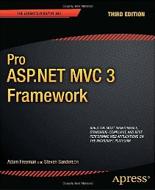
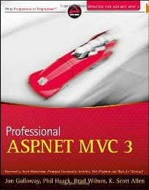
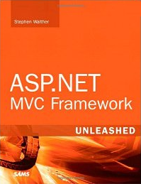
Recommended Books
Pro ASP.NET MVC 3 Framework, Steven Sanderson, Adam Freeman, APress, 3rd edition, 2011, ISBN 1430234040 http://amazon.com/dp/1430234040/
Professional ASP.NET MVC 3, Jon Galloway, Wrox, 2011, ISBN 1118076583 http://amazon.com/dp/1118076583/
ASP.NET MVC Framework Unleashed, Stephen Walther, Sams, 2009, ISBN 0672329980 http://amazon.com/dp/0672329980/

Slide 33

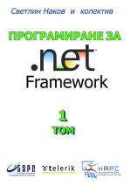

Recommended Books (2)
Nakov S., Kolev V. & Co., Introduction to programming with C#, 2011, ISBN 978-954-400-527-6 http://www.introprogramming.info
Nakov S. & Co., Programming for .NET Framework, Volume 1, ISBN 954-775-505-6, www.devbg.org/dotnetbook/
Nakov S. & Co., Programming for .NET Framework, Volume 2, ISBN 954-775-672-9, www.devbg.org/dotnetbook/

Slide 34
Web Applications with ASP.NET MVC
?
?
?
?
?
Questions?
?
?
?
?
?
http://mvccourse.telerik.com

